Slide 1
Guide to Computer Forensics and Investigations
Third Edition
Chapter 1
Computer Forensics and Investigations as a Profession

Slide 2
Objectives
Define computer forensics
Describe how to prepare for computer investigations and explain the difference between law enforcement agency and corporate investigations
Explain the importance of maintaining professional conduct
Guide to Computer Forensics and Investigations

Slide 3
Understanding Computer Forensics
Computer forensics
  Involves obtaining and analyzing digital information
    As evidence in civil, criminal, or administrative cases
FBI Computer Analysis and Response Team (CART)
  Formed in 1984 to handle the increasing number of cases involving digital evidence
Guide to Computer Forensics and Investigations

Slide 4
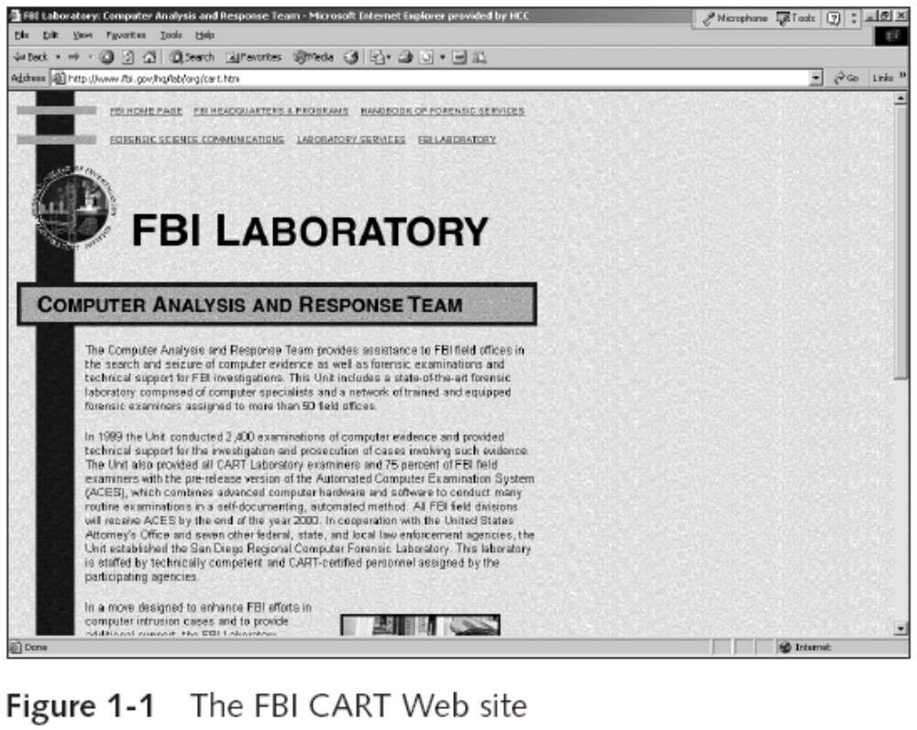
Understanding Computer Forensics (continued)
Guide to Computer Forensics and Investigations

Slide 5
Understanding Computer Forensics (continued)
Fourth Amendment to the U.S. Constitution
  Protects everyone’s rights to be secure in their person, residence, and property
    From search and seizure
  Search warrants are needed
Guide to Computer Forensics and Investigations

Slide 6
Computer Forensics Versus Other Related Disciplines
Computer forensics
  Investigates data that can be retrieved from a computer’s hard disk or other storage media
Network forensics
  Yields information about how a perpetrator or an attacker gained access to a network
Data recovery
  Recovering information that was deleted by mistake
    Or lost during a power surge or server crash
  Typically you know what you’re looking for
Guide to Computer Forensics and Investigations

Slide 7
Computer Forensics Versus Other Related Disciplines (continued)
Computer forensics
  Task of recovering data that users have hidden or deleted and using it as evidence
  Evidence can be inculpatory (“incriminating”) or exculpatory
Disaster recovery
  Uses computer forensics techniques to retrieve information their clients have lost
Investigators often work as a team to make computers and networks secure in an organization
Guide to Computer Forensics and Investigations

Slide 8
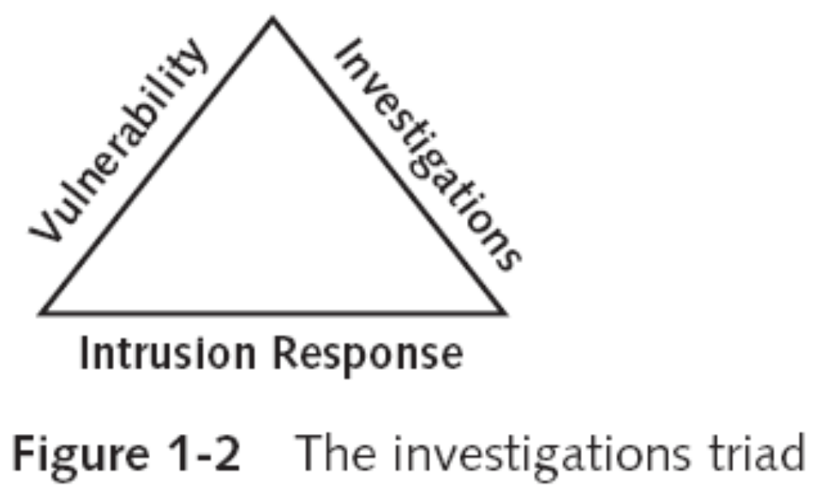
Computer Forensics Versus Other Related Disciplines (continued)
Guide to Computer Forensics and Investigations

Slide 9
Computer Forensics Versus Other Related Disciplines (continued)
Enterprise network environment
  Large corporate computing systems that might include disparate or formerly independent systems
Vulnerability assessment and risk management group
  Tests and verifies the integrity of standalone workstations and network servers
  Professionals in this group have skills in network intrusion detection and incident response
Guide to Computer Forensics and Investigations

Slide 10
Computer Forensics Versus Other Related Disciplines (continued)
Litigation
  Legal process of proving guilt or innocence in court
Computer investigations group
  Manages investigations and conducts forensic analysis of systems suspected of containing evidence related to an incident or a crime
Guide to Computer Forensics and Investigations

Slide 11
A Brief History of Computer Forensics
By the 1970s, electronic crimes were increasing, especially in the financial sector
  Most law enforcement officers didn’t know enough about computers to ask the right questions
    Or to preserve evidence for trial
1980s
  PCs gained popularity and different OSs emerged
  Disk Operating System (DOS) was available
  Forensics tools were simple, and most were generated by government agencies
Guide to Computer Forensics and Investigations

Slide 12
A Brief History of Computer Forensics (continued)
Mid-1980s
  Xtree Gold appeared on the market
    Recognized file types and retrieved lost or deleted files
  Norton DiskEdit soon followed
    And became the best tool for finding deleted file
1987
  Apple produced the Mac SE
    A Macintosh with an external EasyDrive hard disk with 60 MB of storage
Guide to Computer Forensics and Investigations

Slide 13
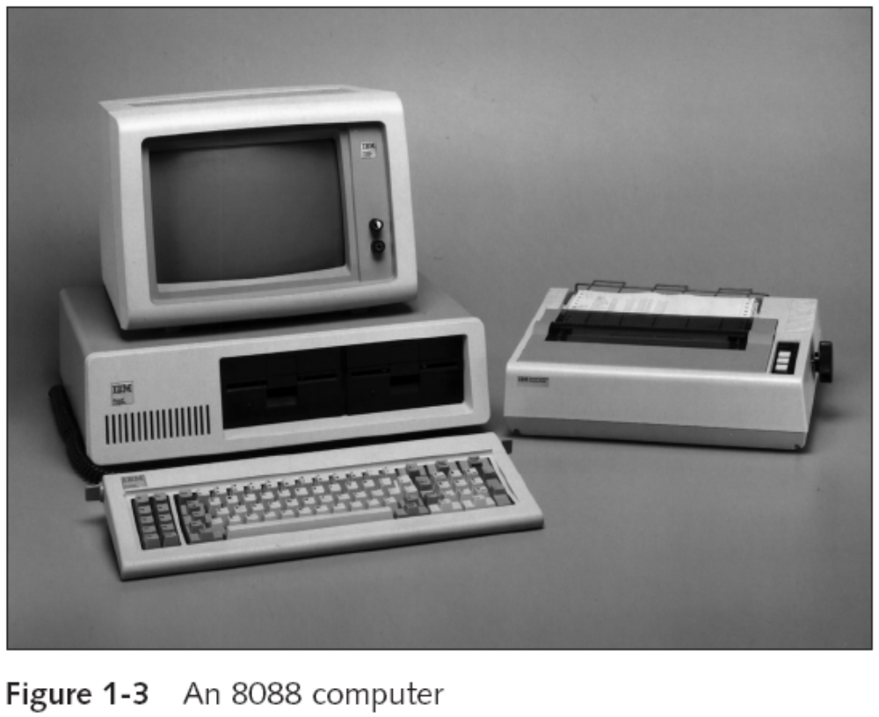
A Brief History of Computer Forensics (continued)
Guide to Computer Forensics and Investigations

Slide 14
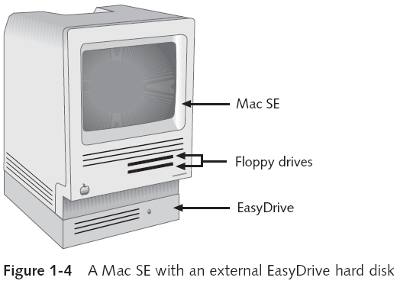
A Brief History of Computer Forensics (continued)
Guide to Computer Forensics and Investigations

Slide 15
A Brief History of Computer Forensics (continued)
Early 1990s
  Tools for computer forensics were available
  International Association of Computer Investigative Specialists (IACIS)
    Training on software for forensics investigations
  IRS created search-warrant programs
  ExpertWitness for the Macintosh
    First commercial GUI software for computer forensics
    Created by ASR Data
Guide to Computer Forensics and Investigations

Slide 16
A Brief History of Computer Forensics (continued)
Early 1990s (continued)
  ExpertWitness for the Macintosh
    Recovers deleted files and fragments of deleted files
Large hard disks posed problems for investigators
Other software
  iLook
  AccessData Forensic Toolkit (FTK)
Guide to Computer Forensics and Investigations

Slide 17
Understanding Case Law
Technology is evolving at an exponential pace
  Existing laws and statutes can’t keep up change
Case law used when statutes or regulations don’t exist
Case law allows legal counsel to use previous cases similar to the current one
  Because the laws don’t yet exist
Each case is evaluated on its own merit and issues
Guide to Computer Forensics and Investigations

Slide 18
Developing Computer Forensics Resources
You must know more than one computing platform
  Such as DOS, Windows 9x, Linux, Macintosh, and current Windows platforms
Join as many computer user groups as you can
Computer Technology Investigators Network (CTIN)
  Meets monthly to discuss problems that law enforcement and corporations face
Guide to Computer Forensics and Investigations

Slide 19
Developing Computer Forensics Resources (continued)
High Technology Crime Investigation Association (HTCIA)
  Exchanges information about techniques related to computer investigations and security
User groups can be helpful
Build a network of computer forensics experts and other professionals
  And keep in touch through e-mail
Outside experts can provide detailed information you need to retrieve digital evidence
Guide to Computer Forensics and Investigations

Slide 20
Preparing for Computer Investigations
Computer investigations and forensics falls into two distinct categories
  Public investigations
  Private or corporate investigations
Public investigations
  Involve government agencies responsible for criminal investigations and prosecution
  Organizations must observe legal guidelines
Law of search and seizure
  Protects rights of all people, including suspects
Guide to Computer Forensics and Investigations

Slide 21
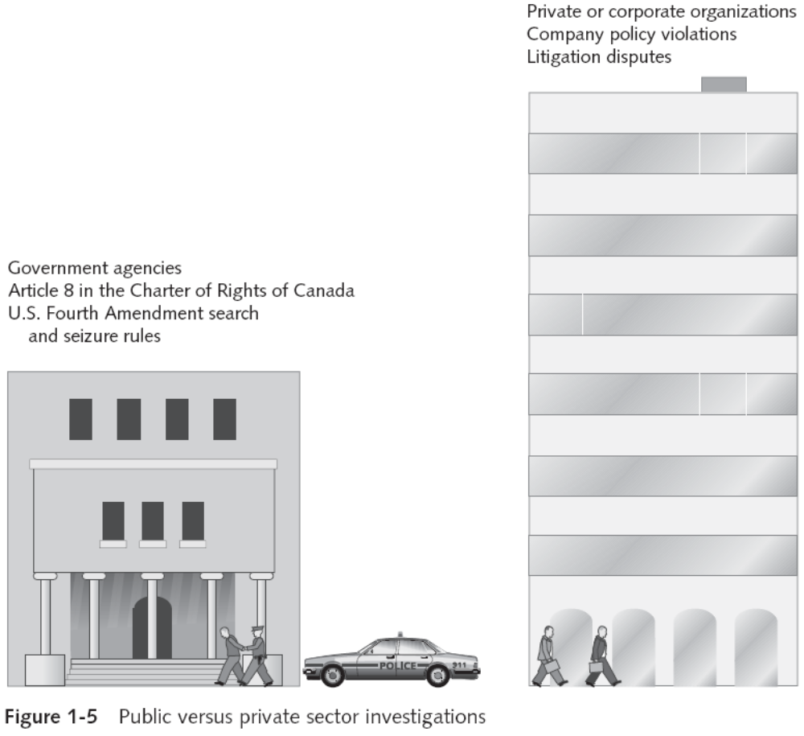
Preparing for Computer Investigations (continued)
Guide to Computer Forensics and Investigations

Slide 22
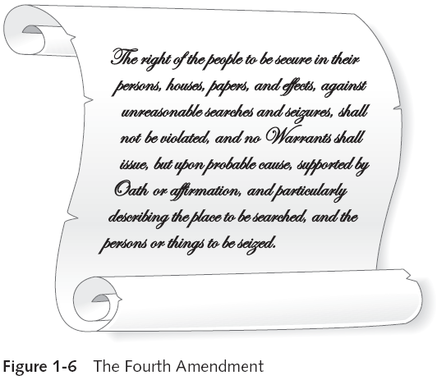
Preparing for Computer Investigations (continued)
Guide to Computer Forensics and Investigations

Slide 23
Preparing for Computer Investigations (continued)
Private or corporate investigations
  Deal with private companies, non-law-enforcement government agencies, and lawyers
  Aren’t governed directly by criminal law or Fourth Amendment issues
  Governed by internal policies that define expected employee behavior and conduct in the workplace
Private corporate investigations also involve litigation disputes
Investigations are usually conducted in civil cases
Guide to Computer Forensics and Investigations

Slide 24
Understanding Law Enforcements Agency Investigations
In a criminal case, a suspect is tried for a criminal offense
  Such as burglary, murder, or molestation
Computers and networks are only tools that can be used to commit crimes
  Many states have added specific language to criminal codes to define crimes involving computers
Following the legal process
  Legal processes depend on local custom, legislative standards, and rules of evidence
Guide to Computer Forensics and Investigations

Slide 25
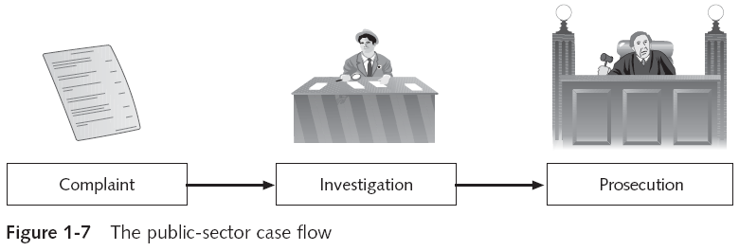
Understanding Law Enforcements Agency Investigations (continued)
Following the legal process (continued)
  Criminal case follows three stages
    The complaint, the investigation, and the prosecution
Guide to Computer Forensics and Investigations

Slide 26
Understanding Law Enforcements Agency Investigations (continued)
Following the legal process (continued)
  A criminal case begins when someone finds evidence of an illegal act
  Complainant makes an allegation, an accusation or supposition of fact
  A police officer interviews the complainant and writes a report about the crime
    Police blotter provides a record of clues to crimes that have been committed previously
  Investigators delegate, collect, and process the information related to the complaint
Guide to Computer Forensics and Investigations

Slide 27
Understanding Law Enforcements Agency Investigations (continued)
Following the legal process (continued)
  After you build a case, the information is turned over to the prosecutor
  Affidavit
    Sworn statement of support of facts about or evidence of a crime
      Submitted to a judge to request a search warrant
    Have the affidavit notarized under sworn oath
  Judge must approve and sign a search warrant
    Before you can use it to collect evidence
Guide to Computer Forensics and Investigations

Slide 28
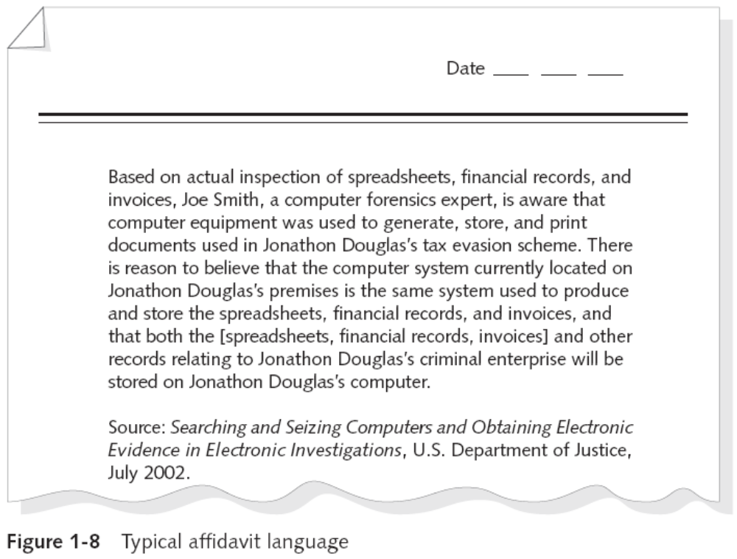
Understanding Law Enforcements Agency Investigations (continued)
Guide to Computer Forensics and Investigations

Slide 29
Understanding Corporate Investigations
Private or corporate investigations
  Involve private companies and lawyers who address company policy violations and litigation disputes
Corporate computer crimes can involve:
  E-mail harassment
  Falsification of data
  Gender and age discrimination
  Embezzlement
  Sabotage
  Industrial espionage
Guide to Computer Forensics and Investigations

Slide 30
Understanding Corporate Investigations (continued)
Establishing company policies
  One way to avoid litigation is to publish and maintain policies that employees find easy to read and follow
  Published company policies provide a line of authority
    For a business to conduct internal investigations
  Well-defined policies
    Give computer investigators and forensic examiners the authority to conduct an investigation
Displaying Warning Banners
  Another way to avoid litigation
Guide to Computer Forensics and Investigations

Slide 31
Understanding Corporate Investigations (continued)
Displaying Warning Banners (continued)
  Warning banner
    Usually appears when a computer starts or connects to the company intranet, network, or virtual private network
    Informs end users that the organization reserves the right to inspect computer systems and network traffic at will
    Establishes the right to conduct an investigation
  As a corporate computer investigator
    Make sure company displays well-defined warning banner
Guide to Computer Forensics and Investigations

Slide 32
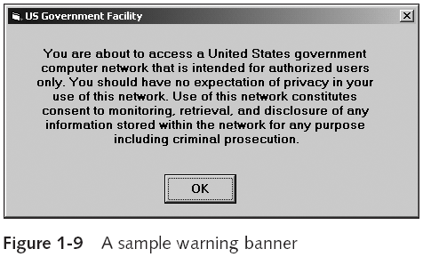
Understanding Corporate Investigations (continued)
Guide to Computer Forensics and Investigations

Slide 33
Understanding Corporate Investigations (continued)
Designating an authorized requester
  Authorized requester has the power to conduct investigations
  Policy should be defined by executive management
  Groups that should have direct authority to request computer investigations
    Corporate Security Investigations
    Corporate Ethics Office
    Corporate Equal Employment Opportunity Office
    Internal Auditing
    The general counsel or Legal Department
Guide to Computer Forensics and Investigations

Slide 34
Understanding Corporate Investigations (continued)
Conducting security investigations
  Types of situations
    Abuse or misuse of corporate assets
    E-mail abuse
    Internet abuse
  Be sure to distinguish between a company’s abuse problems and potential criminal problems
  Corporations often follow the silver-platter doctrine
    What happens when a civilian or corporate investigative agent delivers evidence to a law enforcement officer
Guide to Computer Forensics and Investigations

Slide 35
Understanding Corporate Investigations (continued)
Distinguishing personal and company property
  Many company policies distinguish between personal and company computer property
  One area that’s difficult to distinguish involves PDAs, cell phones, and personal notebook computers
  The safe policy is to not allow any personally owned devices to be connected to company-owned resources
    Limiting the possibility of commingling personal and company data
Guide to Computer Forensics and Investigations

Slide 36
Maintaining Professional Conduct
Professional conduct
  Determines your credibility
  Includes ethics, morals, and standards of behavior
Maintaining objectivity means you must form and sustain unbiased opinions of your cases
Maintain an investigation’s credibility by keeping the case confidential
  In the corporate environment, confidentiality is critical
In rare instances, your corporate case might become a criminal case as serious as murder
Guide to Computer Forensics and Investigations

Slide 37
Maintaining Professional Conduct (continued)
Enhance your professional conduct by continuing your training
Record your fact-finding methods in a journal
Attend workshops, conferences, and vendor courses
Membership in professional organizations adds to your credentials
Achieve a high public and private standing and maintain honesty and integrity
Guide to Computer Forensics and Investigations

Slide 38
Summary
Computer forensics applies forensics procedures to digital evidence
Laws about digital evidence established in the 1970s
To be a successful computer forensics investigator, you must know more than one computing platform
Public and private computer investigations are different
Guide to Computer Forensics and Investigations

Slide 39
Summary (continued)
Use warning banners to remind employees and visitors of policy on computer and Internet use
Companies should define and limit the number of authorized requesters who can start an investigation
Silver-platter doctrine refers to handing the results of private investigations over to law enforcement because of indications of criminal activity
Computer forensics investigators must maintain professional conduct to protect their credibility
Guide to Computer Forensics and Investigations

